Slide 1
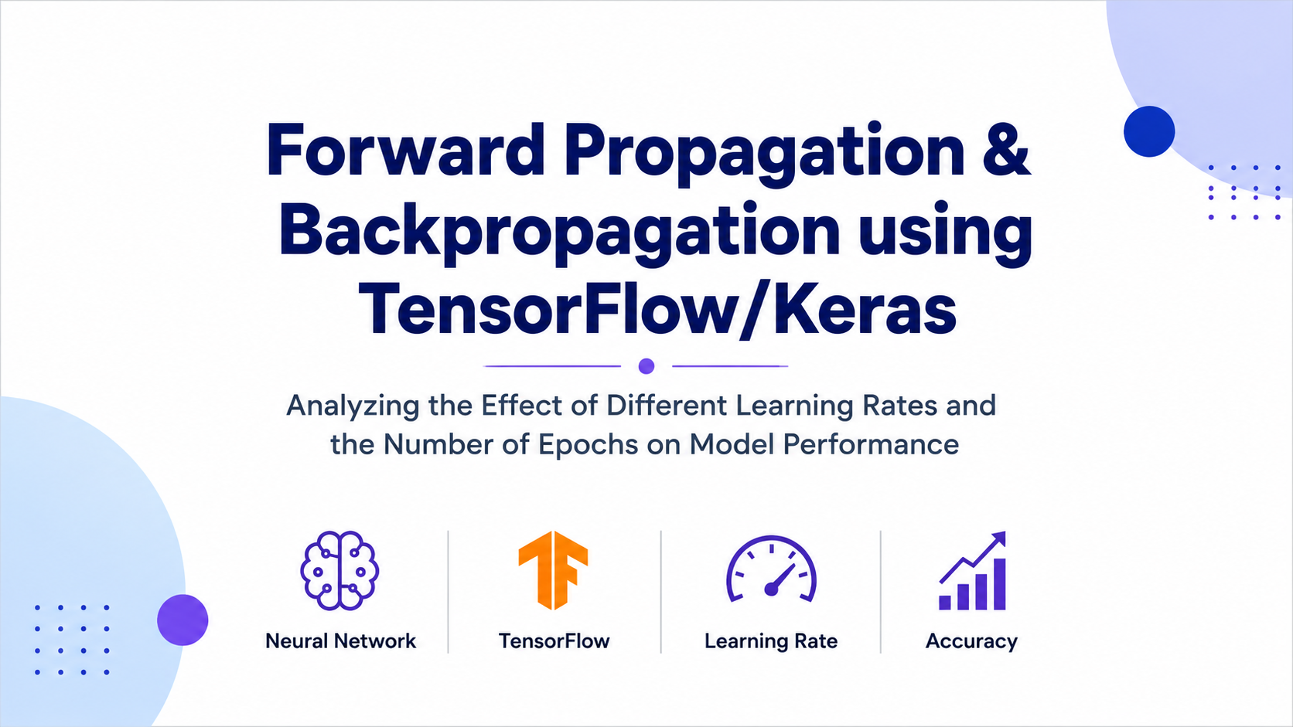

Slide 2


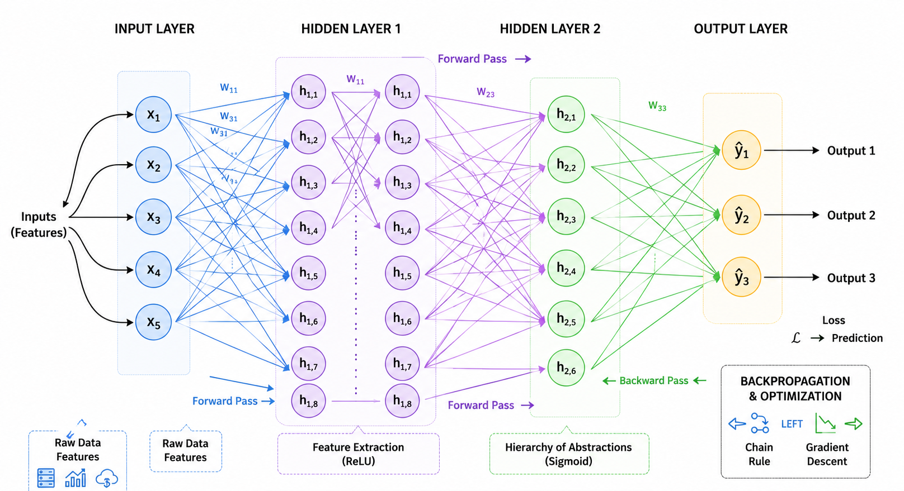
Artificial Neural Network:
It is a computational model inspired by human brain.It consist of interconnected neurons organized into layers that learn patterns from data to perform tasks such as calssification,prediction and recognition
Working
The input layer receives the input data.
The hidden layers process the data and learn meaningful patterns.
The output layer produces the final prediction or classification.

Slide 3

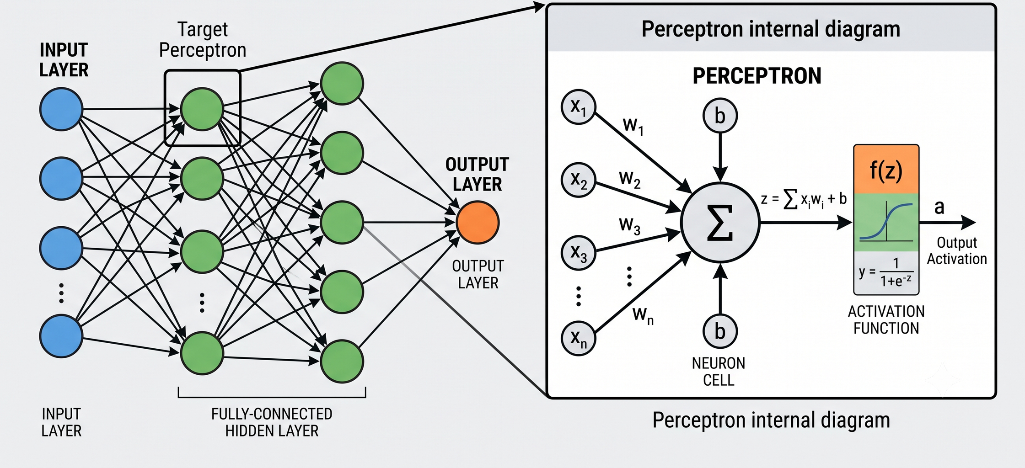
Meet the "Perceptron
A perceptron is the simplest form of an artificial neuron and is considered the basic building block of a neural network. It receives input values, applies weights to them, adds a bias, and produces an output using an activation function.
The result is then passed through an activation function to generate the final output.
.
.

Slide 4




Single Layer Perceptron:
It consist of the input layer which receives raw features from the dataset and output layer consist of one or more perceptron neurons connected directly to input layer.Their are no hidden layers in between ,input signal flow straight into output neuron in single direct step
Linearly Separable Gates
Linearly Separable Gates
Non-Linear XOR Gate
AND Gate:
Rule: Output 1 only when both inputs are 1
Linear Line: x_1 + x_2 = 1.5 (or weights w_1=1, w_2=1, b=-1.5).
Points:
(0 ,0) --> 0
(0,1) --> 0
(1,0) -->0
(1,1) -->1
OR Gate:
Rule: Output 1 if at least one input is 1.
Linear Line: x_1 + x_2 = 0.5 (or weights w_1=1, w_2=1, b=-0.5).
Points: (0,0)--> 0
(0,1)-->1
(1,0)-->1
(1,1)--> 1.
Rule: Output 1 when inputs are different; output 0 when inputs are same.
Points: (0,0)--> 0, (1,1)--> 0, (0,1)--> 1, (1,0)-->1.
The Problem: The 1's sit diagonally opposite each other across from the 0's. No single straight line can split two diagonal pairs.

Slide 5
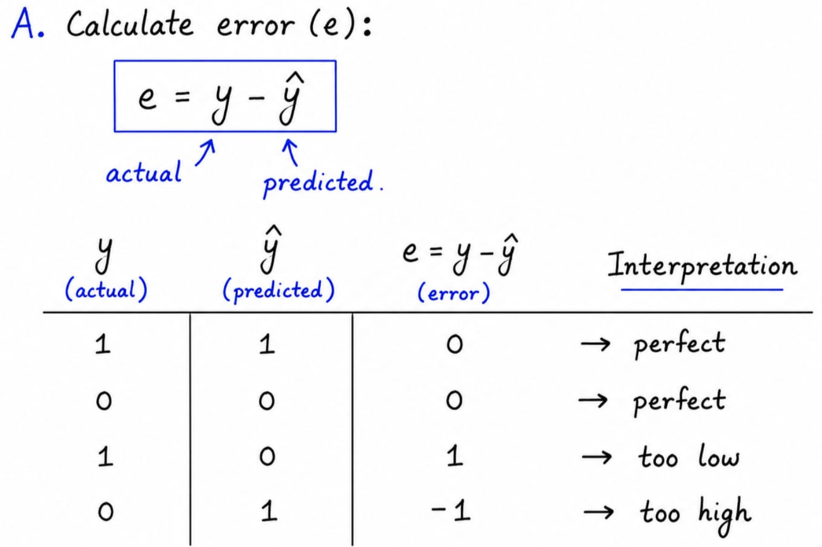
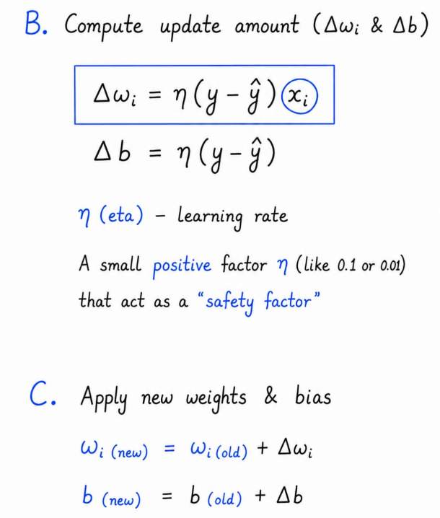
Perceptron Learning Rule:
Initially weights and bias are random or ‘0’
To update any weight(wi) , perceptron follows 3 simple steps

Slide 6
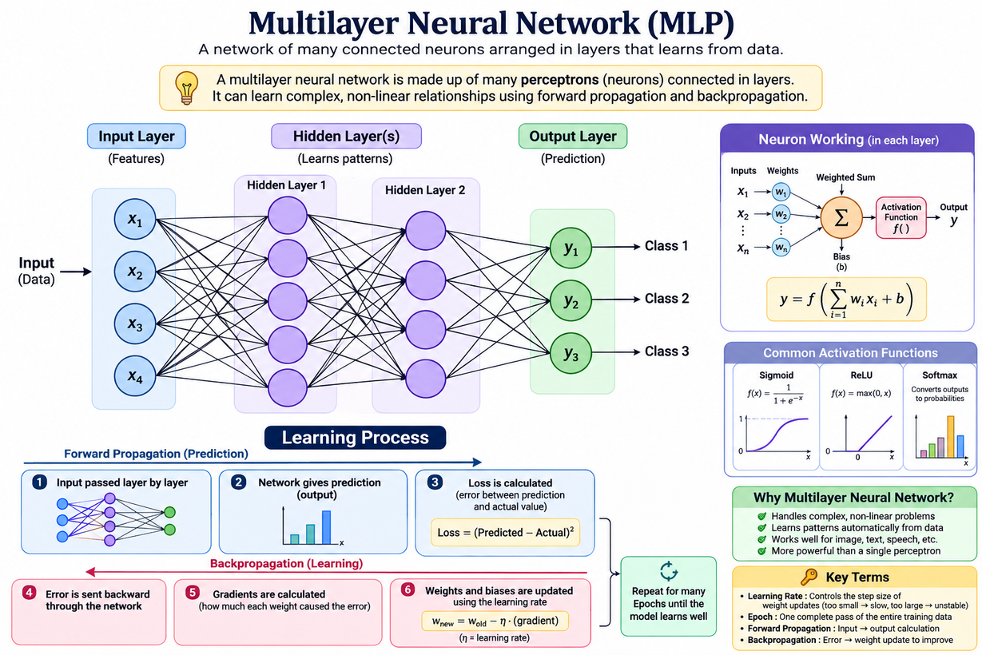
Multi-Layer Neural Networks
A Multilayer Neural Network (MLP) is a machine learning model made up of many artificial neurons arranged in layers.

Slide 7
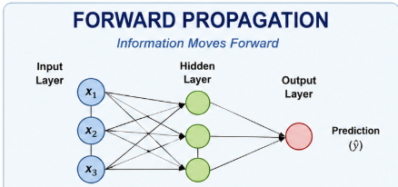
Step 1: Forward Propagation (Guessing!)
Forward propagation is the process of passing input data through the neural network from the input layer to the output layer.

Slide 8
Loss Function
A loss function measures the difference between the actual output and the predicted output.
Cost Function
A cost function represents the average loss over the entire training dataset.
The loss function usually measures the error for an individual example, while the cost function aggregates the error across all training examples.

Slide 9
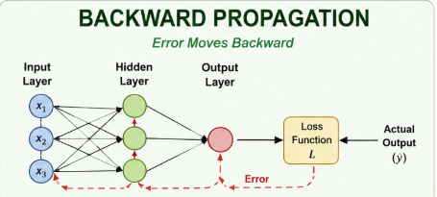
Step 2: Backpropagation (Learning!)
Backpropagation helps the neural network learn from its mistakes by adjusting the weights and biases based on the error.

Slide 10
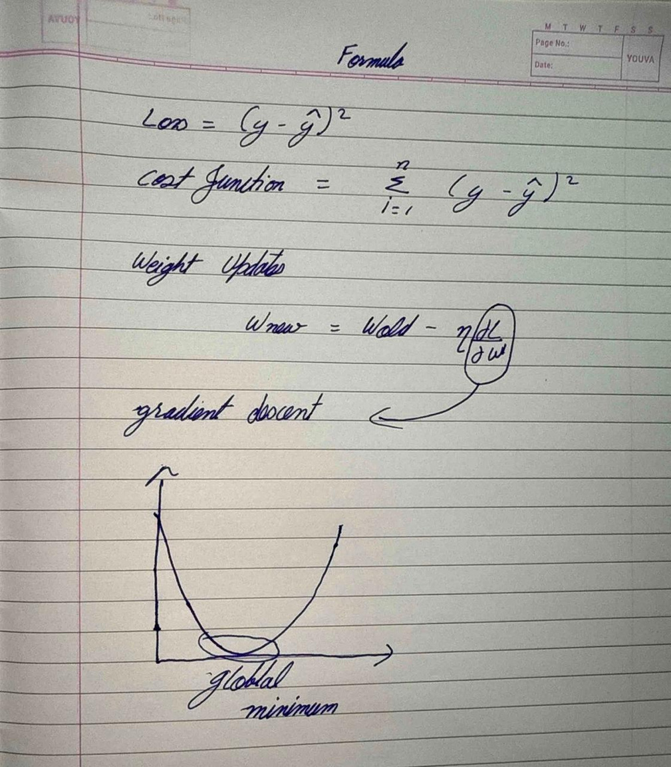

Slide 11
Step 2: Backpropagation (Learning!)
What is an Optimizer?
An optimizer is an algorithm used to update the weights and biases of a neural network during training.
What is Gradient Descent?
Gradient Descent is an optimization algorithm used to minimize the loss or cost function.

Slide 12
Step 2: Backpropagation (Learning!)
Challenges in Gradient Descent
1. Learning Rate Selection
A learning rate that is:
Too small → Training becomes very slow
Too large → The model may overshoot the minimum and become unstable
2. Local Minima
The algorithm may reach a point where the loss is low but not the lowest possible value.
3. Saddle Points
The gradient may become very small, causing the model to learn extremely slowly.
4. Vanishing Gradients
Gradients become extremely small as they move backward through deep networks.
This makes learning difficult.
5. Exploding Gradients
Gradients become extremely large, causing unstable weight updates.

Slide 13


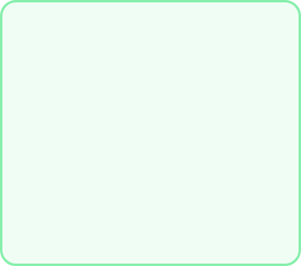





Learning Rate: How Big Are Your Steps?
The learning rate is a hyperparameter that determines the size of the steps taken by a neural network while updating its weights during training.
Too Big (e.g., 10.0)
Just Right (e.g., 1.0)
Too Small (e.g., 0.001)
The robot jumps wildly past the target and gets completely lost!
Smooth, steady steps right down to zero errors! Perfect balance!
Baby steps! Taking millions of years to make any progress.

Slide 14

Epochs: Practice Makes Perfect!
An epoch is one complete pass through the entire training dataset during the training process.
Practice Round (Epoch) | Robot's Guess | Error Level | How the Robot Feels
Epoch 1 | Total wild guess! | Very High (90%) | Confused
Epoch 100 | Getting warmer... | Medium (30%) | Improving
Epoch 1000 | Near perfect accuracy! | Near Zero (0.8%) | Mastered It!

Slide 15
Conclusion
Forward propagation calculated the output, while backpropagation updated the network's weights to reduce errors. The experiment showed that the learning rate controls how fast the model learns, and the number of epochs controls how many times the model learns from the data. A very low learning rate can make training slow, while a very high learning rate can make training unstable. Too few epochs may cause underfitting, while too many may cause overfitting. Therefore, choosing a suitable learning rate and number of epochs is important for achieving good model performance.

Slide 16

Thank You

